Slide 1



Slide 2

Pandemic & Resilience
Jim Reavis

Slide 3
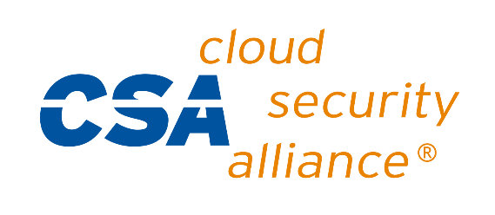

www.cloudsecurityalliance.org
Cloud & COVID-19

Slide 4
COVID-19 & Cloud Impact
Greater usage of cloud in response to pandemic
Overall resilience strong
Mistakes made in rush to “Work From Home”
Companies in “clean up” mode
Problems identified with legacy IT systems
Experience pointing the way to new enterprise architectures
Questions about health of cybersecurity industry

Slide 5
COVID-19 Cloud Usage
Cloud providers and customers report spike in usage
Isolated reports of resource exhaustion in new IaaS service provisioning
Some cloud collaboration and conferencing tools overwhelmed
Overall, cloud scalability was successful

Slide 6
COVID-19 Common Problems
COVID-19 related attacks (e.g. Phishing)
Work from Home configurations insecure
Traditional VPNs and VDI (Virtual Desktop Infrastructure) not designed for 100% virtual workforce
Some security controls loosened for agility

Slide 7
COVID-19 Key Lessons Learned
Cloud adopting companies tend to do better than legacy IT – cloud is the future
Multifactor authentication and SSO very important
Software Defined Perimeter & Zero Trust are new blueprint for enterprise architectures
Hybrid & multi-cloud enterprises need to effectively move workloads quickly between IaaS platforms

Slide 8
COVID-19 Cybersecurity Industry Impact?
Cybersecurity industry is more important than ever
Concerns about global economic crash
Nightmare scenario:
Global economy sinks into depression (20% or more unemployment)
Companies must downsize or even eliminate cybersecurity department
Organized crime moves in, attacks and controls weaker companies – the new cybersecurity department

Slide 9
CSA Roadmap

Slide 10
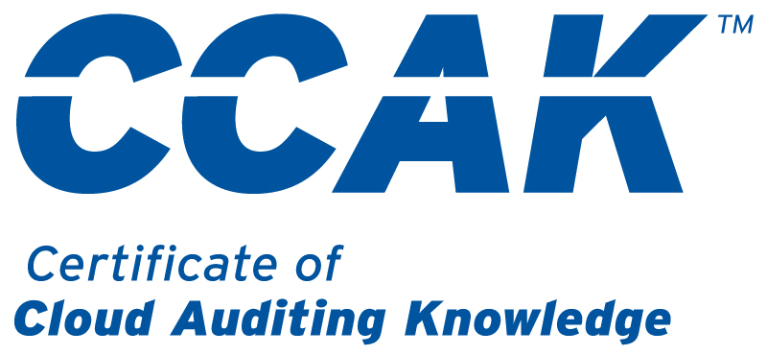
Certificate of Cloud Auditing Knowledge
A new individual professional credential under development by CSA
Demonstrates expertise in understanding the essential principles of Governing and Auditing cloud computing systems.
Exam, online and in-person training
Available in Q4 2020
Site for information and announcements: https://cloudsecurityalliance.org/education/ccak

Slide 11
Research Priorities
Build new architectures and strategies
DevOps & DevSecOps to to achieve high levels of automation in the cloud backend
AI to improve accuracy and automation of holistic systems
Blockchain as the World Wide Ledger of Trust to provide an immutable framework for audit and technology enumeration
Enterprise architectures harmonizing SDP, Zero Trust & 5G
Document AI weaknesses and threats to cybersecurity
Crypto & Key Mgt reference architectures to secure applications, data and workloads at all points
Update CSA security controls frameworks for state-of-the-art serverless, containerized and microsegmented technologies
Increased secure developer guidance
Create “quantum safe” deadlines for updates to prevent quantum attacks
You can participate in all of it through C-CSA! www.c-csa.cn

Slide 12
Summary
COVID-19 highlights the benefits of a Cloud First, virtual strategy
Cloud computing has proven resilient and scalable during the pandemic
Concerns about economic impacts on cybersecurity
CSA accelerating research to enable broader adoption and assurance of cloud

Slide 13

Thanks！

